Slide 1
Adventures in Food
Fast-Food for people in a hurry

Slide 2
Why another fast-food place ?
People are busy. They do not have time to enjoy a leisurely meal especially for lunch
The fast-food places that are operating currently do not offer variety in their menu. There are no healthy alternatives too.
It is completely possible to combine healthy eating with an ever changing and interesting menu options gathered from many parts of the world

Slide 3
Choice of location
Places that have good demographic diversity.
Places where population is increasing
Places with high median income
Places where average worker wages are consistent, neither too low nor too high, which would be easy to find workers
Location narrowed to The woodlands city in the Montgomery county

Slide 4
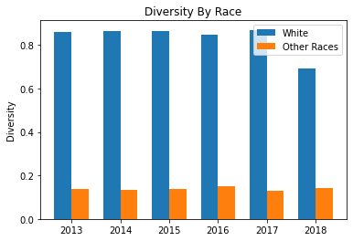
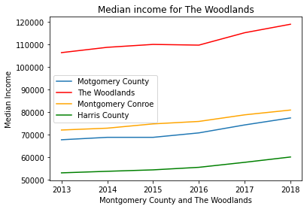
Income and demography comparisons

Slide 5
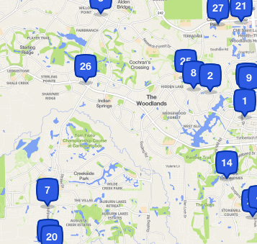
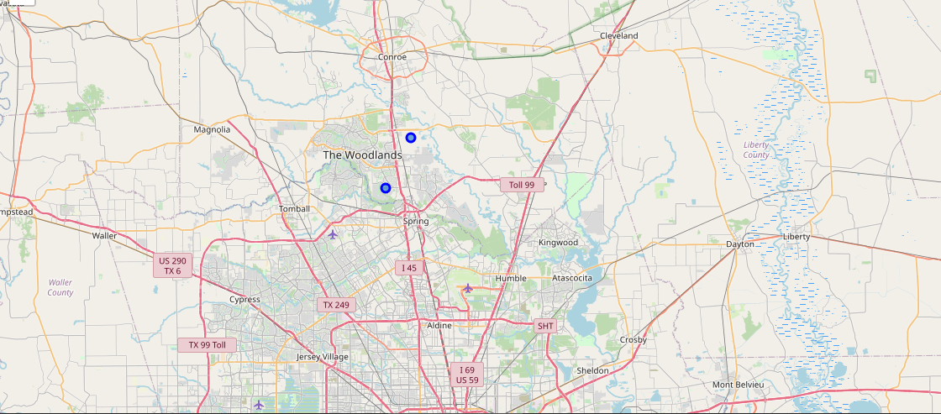
Competition from other fast-food places

Slide 6
Conclusion
In the city of The Woodlands, there are fast-food places that are run by the big chains and few that offer healthy food. It says that there would be interest in trying out a new and interesting eating place.
Data:
http://gis.mctx.org/
https://datausa.io/
Four Square

